Slide 1
High-Dimensional Bayesian Optimization with Multi-Task Learning for RocksDB
조성운

Slide 2
목차
Abstract
Introduction
Background
Structured multi-task optimization
Evaluation
Conclusion

Slide 3
Abstract
Maximizing the throughput of RocksDB IO operations by auto-tuning then parameters of varying ranges
High-Dimensional Problem
multi-task modeling
dimensionality reduction through clustering

Slide 4
Introduction
Auto-tuning method 필요한 이유
A high-dimensional optimization space is a common phenomenon in general-purpose systems as they have many parameters and objectives
파라미터와 측정 결과값을 모두 확인하여 결정하는 것은 어렵다.

Slide 5
Introduction
Bayesian Optimization(BO)
A sample efficent tuner, has received considerable attention in recent years due to its versatility and efficiency
The framework, first builds a system model and then uses the model to find an optimal config-uraiton

Slide 6
Introduction
BO’s drawback is its inability to handle heigh-dimensional spaces
Curse of dimensionality
A computationally expensive operation in the surrogate model
Optimizing over multiple targets to increase learning mileage per training sample
Decomposes into a subset of system components that influence the primary target.

Slide 7
Background
RocksDB is a key-value store based on LevelDB that provides efficient concurrent reads and writes
RocksDB stores new data in a Log-Structured Merge-Tree(LSM-Tree) format in memory
Once the memtable is full, RocksDB flushes it sequentially into a Sorted Sequence Tree(SST) file on disk
Rocks DB still processes concurrent writes during the flushing process
SST organizes the data in levels starting from level-0 to level-n
When a level is full, it performs a housekeeping operaion(compaction) that merges and removes tombstones
During compaction, RocksDB stalls new writes, leading to a reduced IO throughput and increased latency

Slide 8
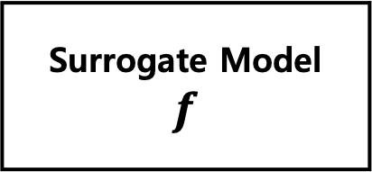
Background
Bayesian Optimization
BO is a sample efficient optimization framework that solves the problem of block-box function optimization
Surrogate Model
$$f$$
argmax Acquisition
function
contains a belief of the system and updates at every now observation
performs numerical optimization operations over the model to find configurations to test next on the objective function

Slide 9
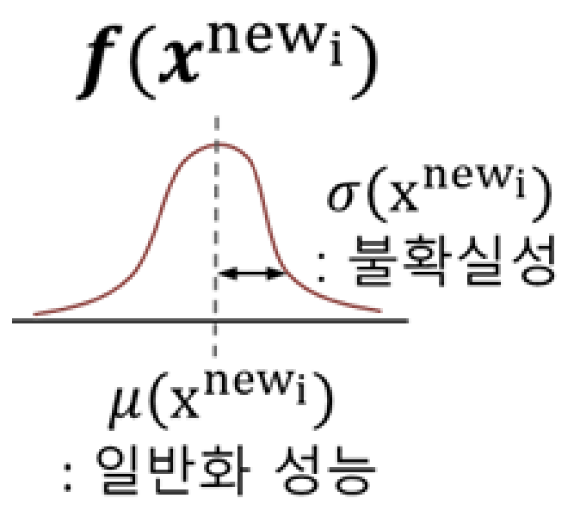
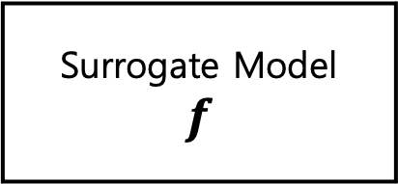
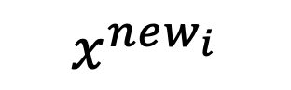
Background
Learning Rate | # of iterations | # of hidden layers | … | Mini batch size
0.001 | 100 | 3 | ... | 128
0.001 | 100 | 3 | … | 128
Performance
100
200
X
Y
$$x^{new_{i}}$$
Surrogate Model
$$f$$
새로운 하이퍼파라미터 집합

Slide 10
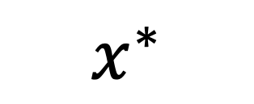
argmax Acquisition
function
$$x^{∗}$$
Learning Rate | # of iterations | # of hidden layers | … | Mini batch size
0.001 | 100 | 3 | ... | 128
0.001 | 100 | 3 | … | 128
Performance
100
200
X*

Slide 11
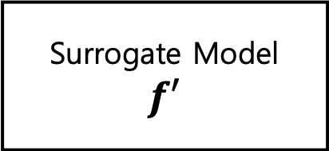
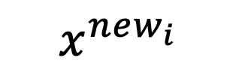
Learning Rate | # of iterations | # of hidden layers | … | Mini batch size
0.001 | 100 | 3 | ... | 128
0.001 | 100 | 3 | … | 128
Performance
100
200
X’
Y’
$$x^{new_{i}}$$
Surrogate Model
$$f′$$
새로운 하이퍼파라미터 집합

Slide 12
Structured multi-task optimization
overveiw
Used multi-task learning to capture the intersection between system components
Learn more from every sample, reducing the observation needed for convergence
Reduces the dimensions through a manual grouping of parameters to speed up the convergence

Slide 13
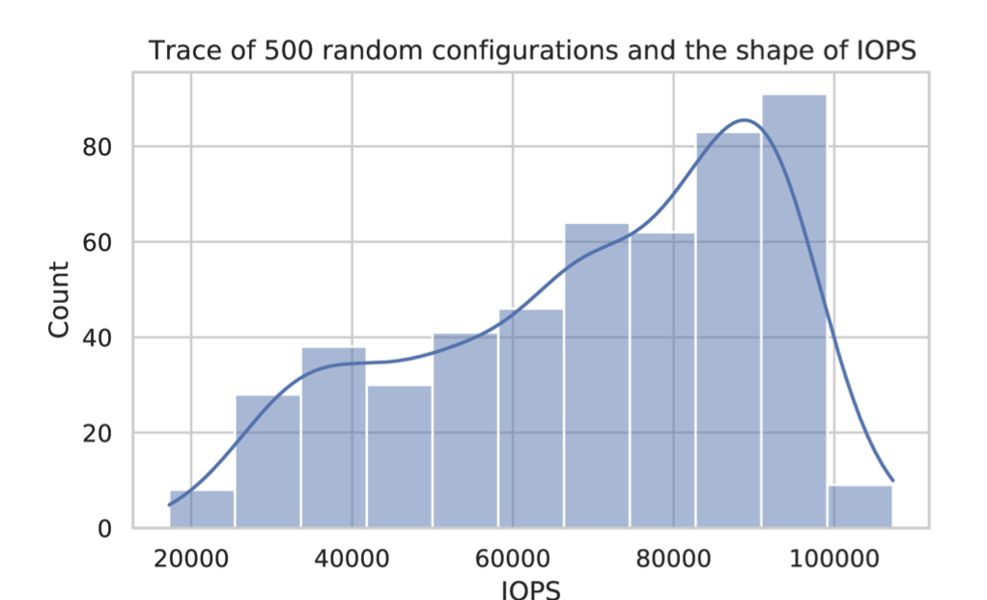
Problem space and assumptions
The fundamental assumption in using GP
the function is differentiable at every point
the modeling space is a multivariate Gaussian distribution
We performed 500 independent experiments where we randomly sampled the modeling space(then parameters)

Slide 14
Multi-task learning
Chose three additional objectives based on our understanding of Rocks DB architecture
WriteAmplification : the ratio of bytes written to storage to the bytes written to the backend.
ReadBlockGetP99 : The 99th percentile latency to read a block of data.
Level0Tolevel1P99 : The 99th percentile time it takes to compact blocks stored in level0 to level1.

Slide 15
Multi-task learning
A machine learning method based on shared representations, which uses task multitasking for learning
Task1
Training Data
Model
Output1
Training
Task2
Training Data
Model
Output2
Task3
Training Data
Model
Output3

Slide 16
Multi-task learning
A machine learning method based on shared representations, which uses task multitasking for learning
WriteAmplification
Training Data
Model
Output1
Training
ReadBlockGetP99
Training Data
Model
Output2
LevelTolevel1P99
Training Data
Model
Output3

Slide 17
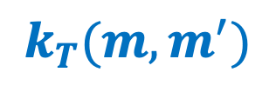
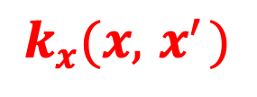
Multi-Task learning in GP
Intrinsic Coregionalization Model (ICM kernel)
$$k\left(\left(x, m\right), \left(x^{′}, m^{′}\right)\right) = k_{x}\left(x, x^{′}\right)k_{T}(m, m^{′})$$
$$k_{x}(x, { x}^{′})$$
The parameter covariance kernel
$$k_{T}(m, m^{′})$$
The task similarity kernel

Slide 18
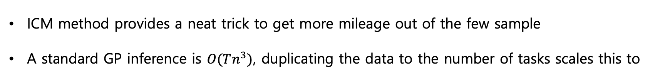
ICM challenges
ICM method provides a neat trick to get more mileage out of the few sample
A standard GP inference is $O(Tn^{3})$, duplicating the data to the number of tasks scales this to
Curse of dimensionality
문제 해결되지 않음!!

Slide 19
Decomposability through clustering
The decomposability refers to the smallest unit of obseravable RocksDB’s performace metric and a corresponding set of parameters in this context
Using the 500 random configurations thrace, we calculated the correlations between IOPS and the 517 observable metric from RocksDB and the correlations between them to the parameters
30개 군집으로 clustering!!

Slide 20
Decomposability through clustering
각 architecture와 관련있는 cluster와 parameter들을 입력값으로 Bayesian Optimization 진행

Slide 21
Decomposability through clustering

Slide 22
Evaluation
used RocksDB’s benchmark tool db_bench
Set a budget of 100 optimization steps

Slide 23
Evaluation
IO Troughput이 가장 높다
가장 빠르게 증가한다

Slide 24
Conclusion
The tuner exploits alternative observable metrics and structural decomposability to converge faster and reduce the dimensional space
Utilize multi-task learning to provide an accessible mechanism for expressing structure in the model
Tuner outperformed the default configuration by x1.35 in 10 iterations, compared to the other state-of-the-art methods requiring 60 iterations

